Slide 1
Zalo AI 2023
Elementary Math Solving
AI VIETNAM
Seminar
Bui Van Hop
Pham Bao Loc
Nguyen Thanh Dong
Phan Van Phuc

Slide 2
Table of Content
AI VIETNAM
Seminar
Content
Introduction
Related Work
Proposed Method
Experiments
Top solutions
Conclusion

Slide 3
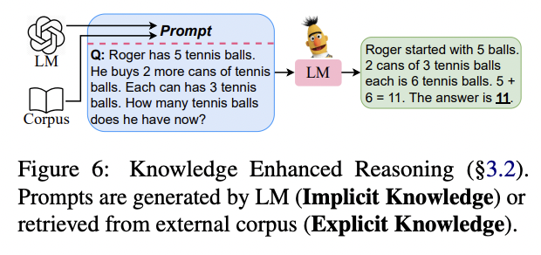
Introduction
AI VIETNAM
Seminar
Introduction
Reasoning with LLM
Reasoning with Language Model Prompting: A Survey

Slide 4
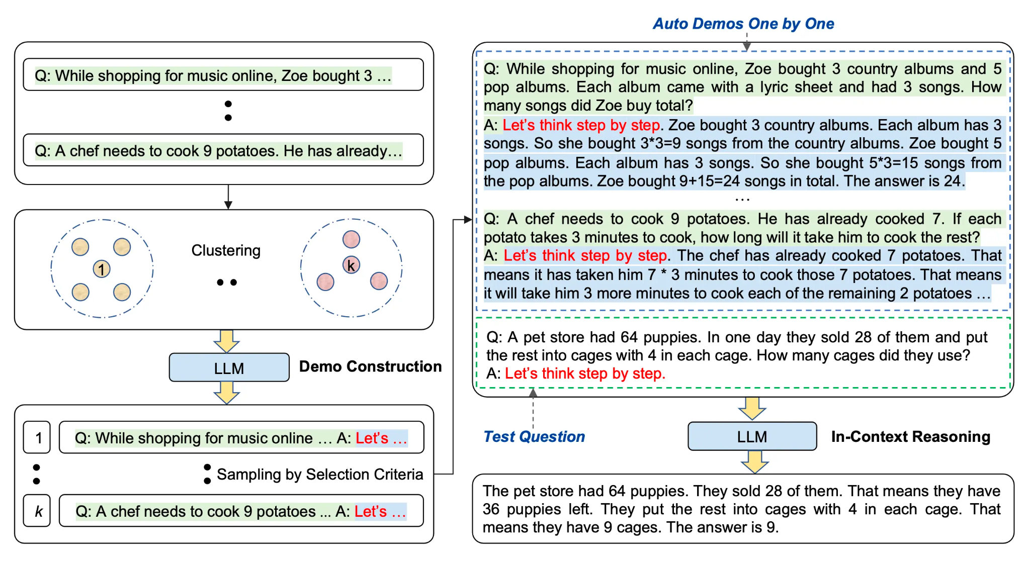
Introduction
AI VIETNAM
Seminar
Introduction
In-context Learning for Reasoning LLM
Chain-of-Thought Prompting Elicits Reasoning in Large Language Models

Slide 5
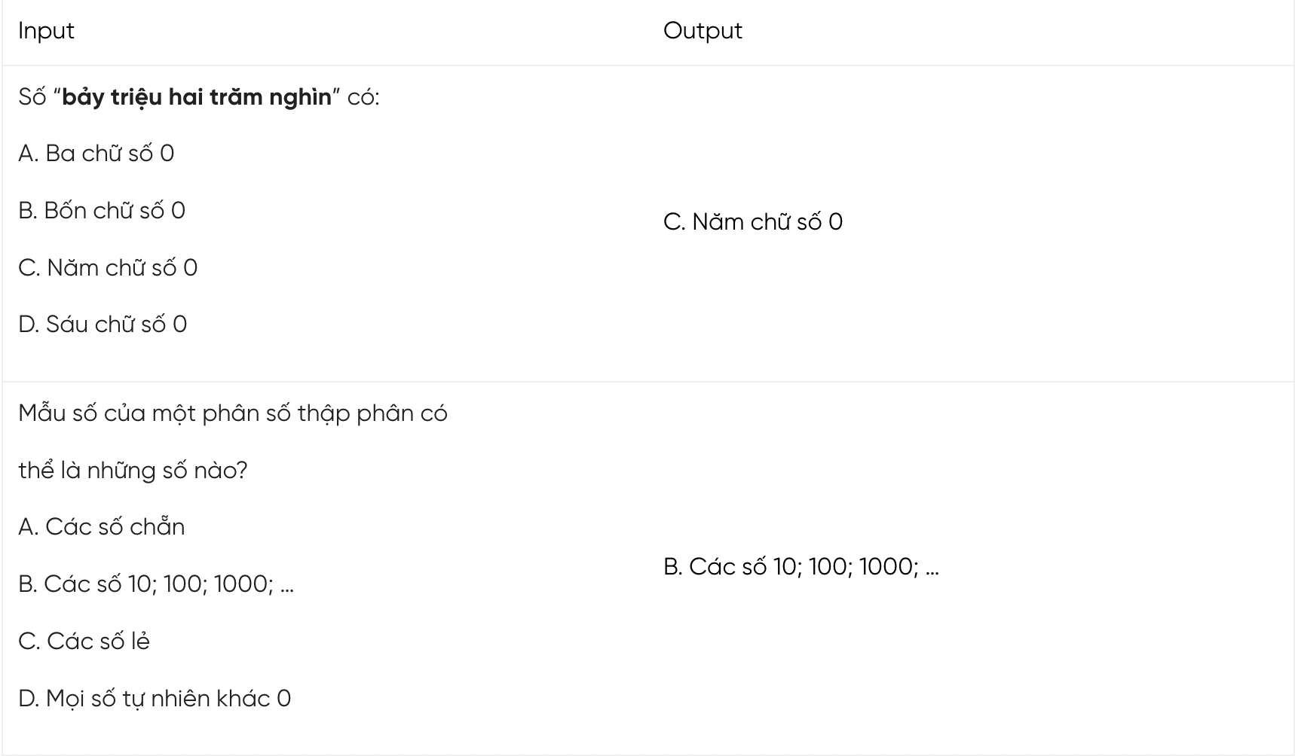
Introduction
AI VIETNAM
Seminar
Problem Definition
Domain knowledge: Vietnamese elementary math.
Format: multiple-choice question.
Input: A multiple choices math question which have 4 possible choices which only one is the correct answer.
Output: The correct choice for the given math question.

Slide 6
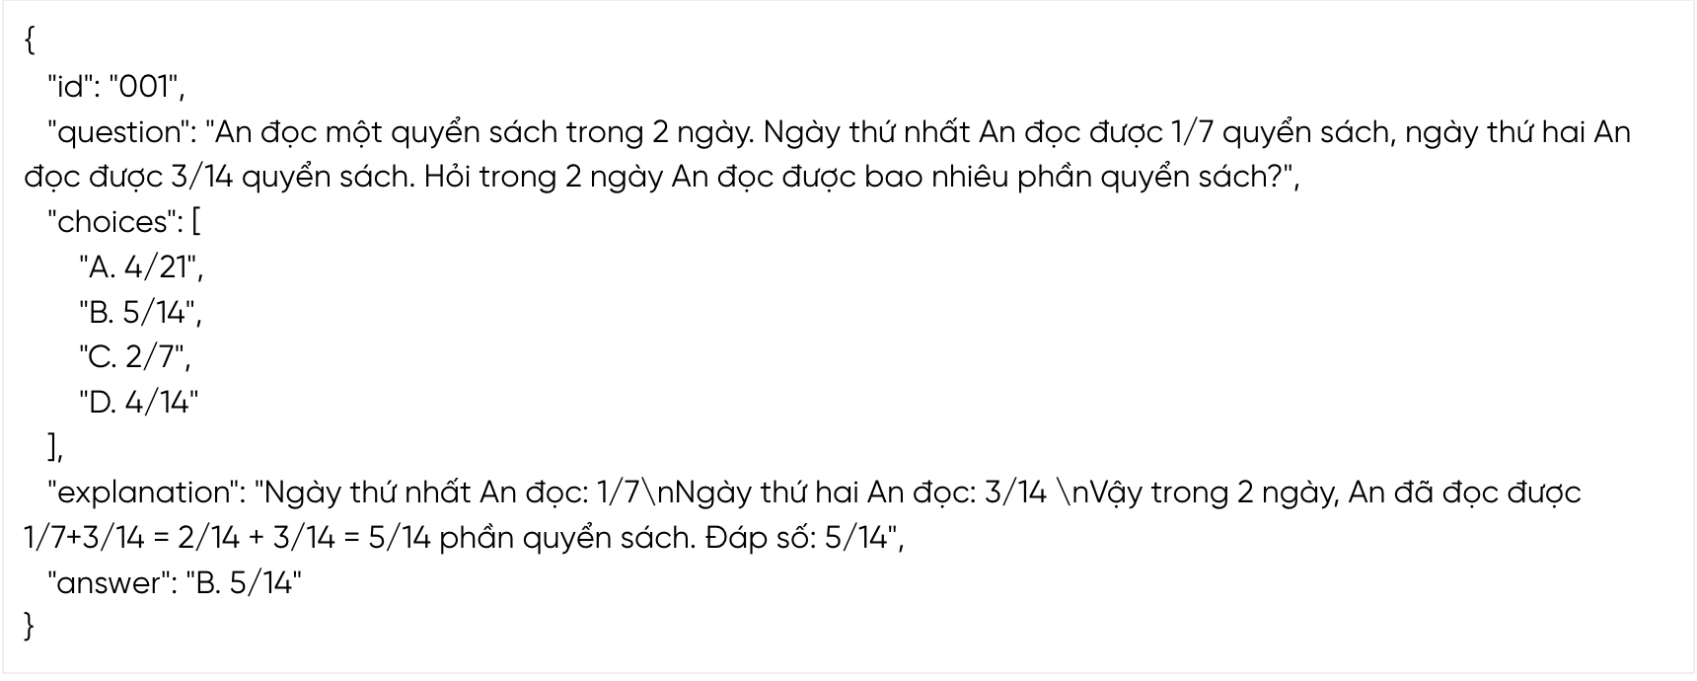
Introduction
AI VIETNAM
Seminar
Dataset
Train data: 1200 math problems with question, choices, answer. Only a half with explanation fields.
Public test: 200 samples with question, choices.
Private test: 300 samples with question, choices.
an example of full math problem example

Slide 7
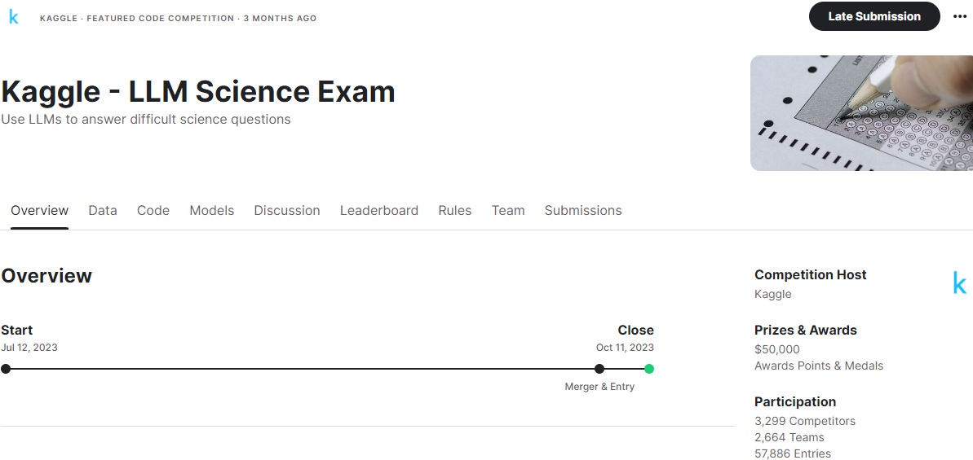
Related Work
AI VIETNAM
Seminar
Inspiration from Kaggle
Inspired by the OpenBookQA dataset, this competition challenges participants to answer difficult science-based questions written by a Large Language Model.
Your work will help researchers better understand the ability of LLMs to test themselves, and the potential of LLMs that can be run in resource-constrained environments.

Slide 8
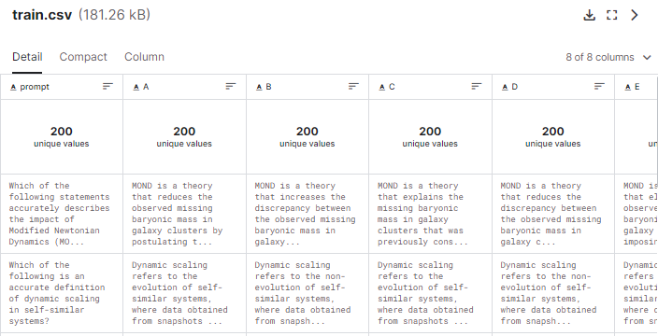
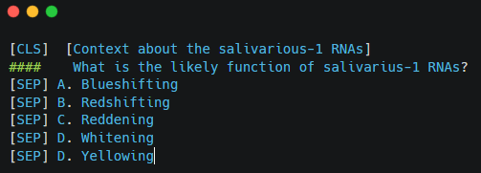
Related Work
AI VIETNAM
Seminar
Inspiration from Kaggle
Data training original is small (~200 records). Which contains prompt (question and context), answer (A, B, C, D, E, etc).
Baseline approach in this competition is just using microsoft/deberta-v3-base as ModelForMultipleChoice
Reason for poor performance comes from deberta_v3_large is not trained on Vietnamese

Slide 9
Related Work
AI VIETNAM
Seminar
Inspiration from Kaggle
Data training original is small (~200 records). Which contains prompt (question and context), answer (A, B, C, D, E, etc).
Baseline approach in this competition is just using microsoft/deberta-v3-base as ModelForMultipleChoice
Reason for poor performance comes from deberta_v3_large is not trained on Vietnamese

Slide 10
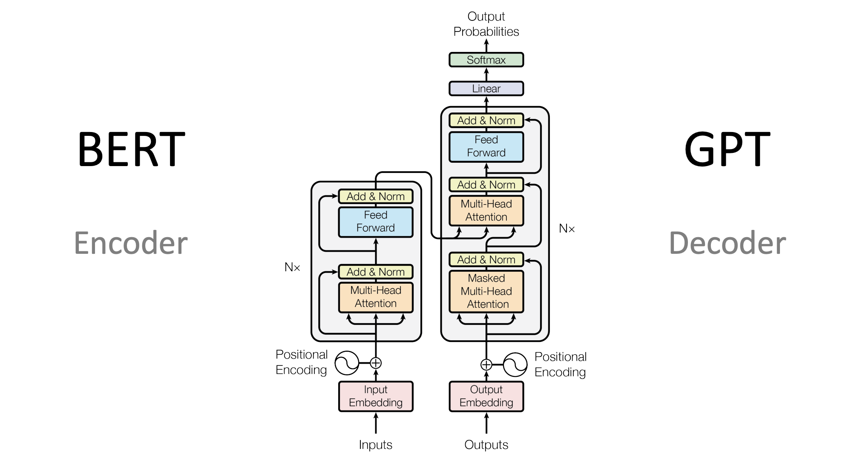
Introduction
AI VIETNAM
Seminar
Large Language Models
Transformers Paper: https://arxiv.org/abs/1706.03762
Image Reference: https://heidloff.net/article/foundation-models-transformers-bert-and-gpt/

Slide 11
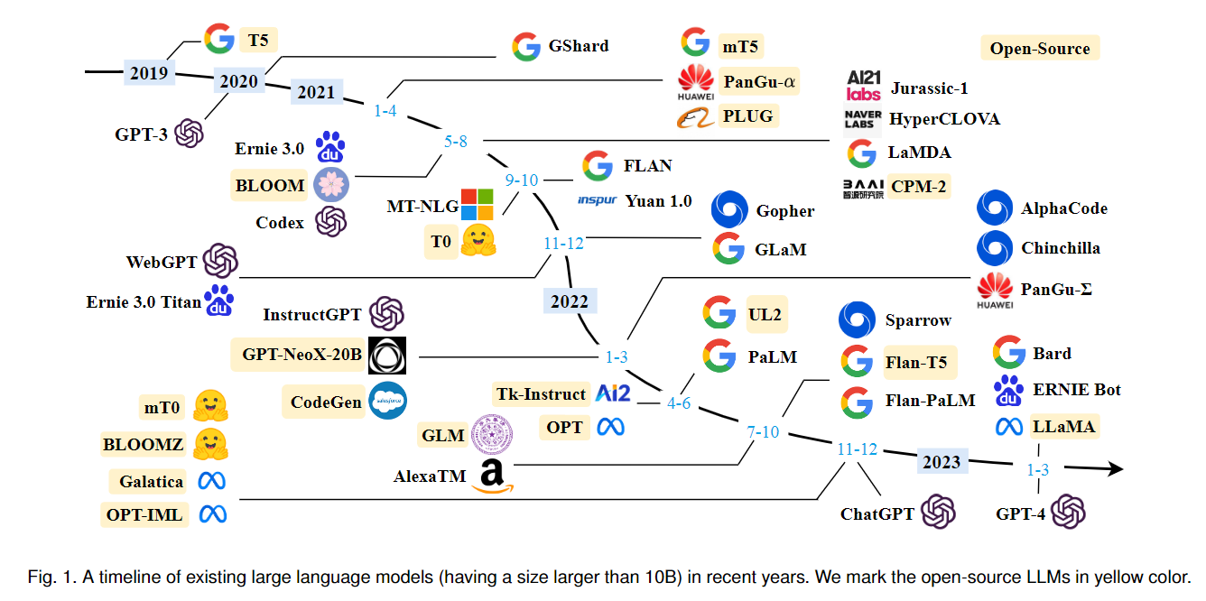
Related Work
AI VIETNAM
Seminar
Large Language Models
LLMs (Large Language Models): Are language models that were trained on a very large corpus of text. This made them capable of performing various NLP tasks with high precision.
Image Reference: https://wandb.ai/vincenttu/blog_posts/reports/A-Survey-of-Large-Language-Models--VmlldzozOTY2MDM1

Slide 12
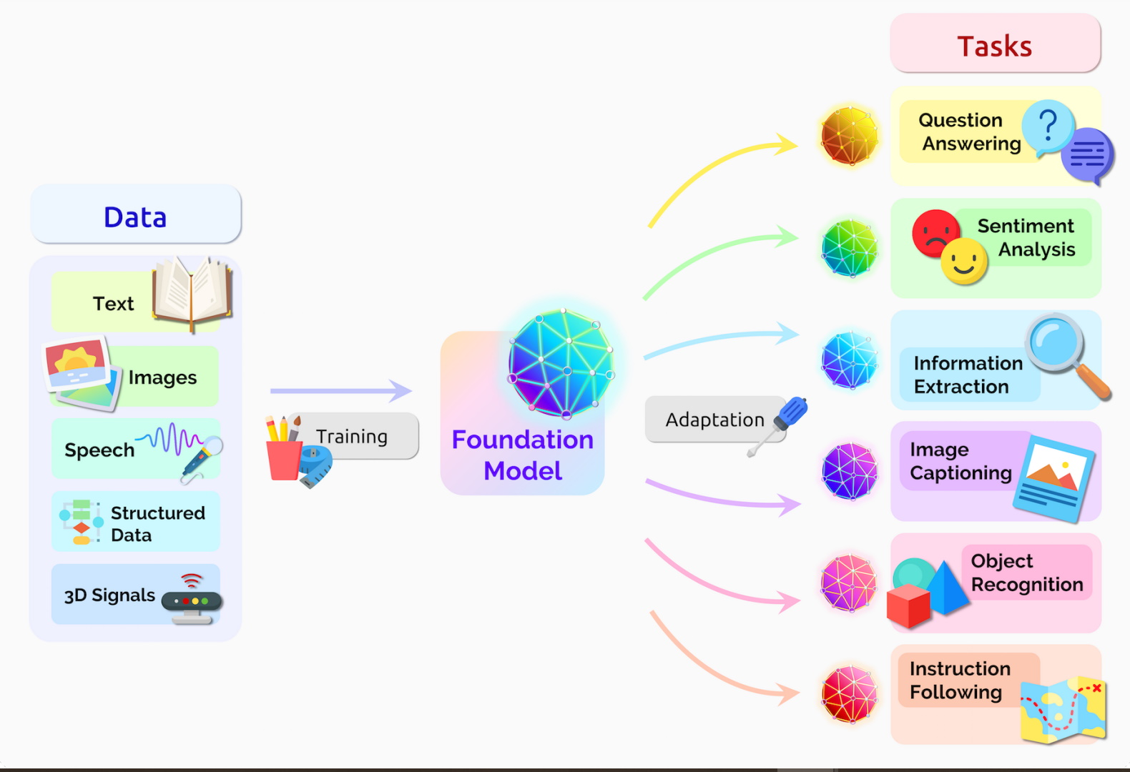
Related Work
AI VIETNAM
Seminar
Large Language Models
LLMs are often pretrained on a vast majority of data and designed to be adaptable to a wide variety of tasks (Foundation models).
Image Reference: https://blogs.nvidia.com/blog/what-are-foundation-models/

Slide 13
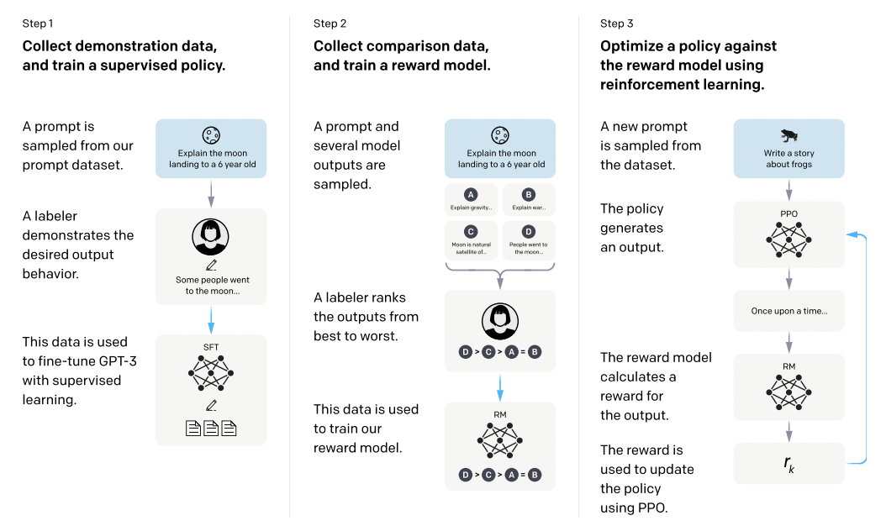





Related Work
AI VIETNAM
Seminar
Large Language Models
Closed-source
Open-source
InstructGPT - Training GPT with Human Feedback

Slide 14
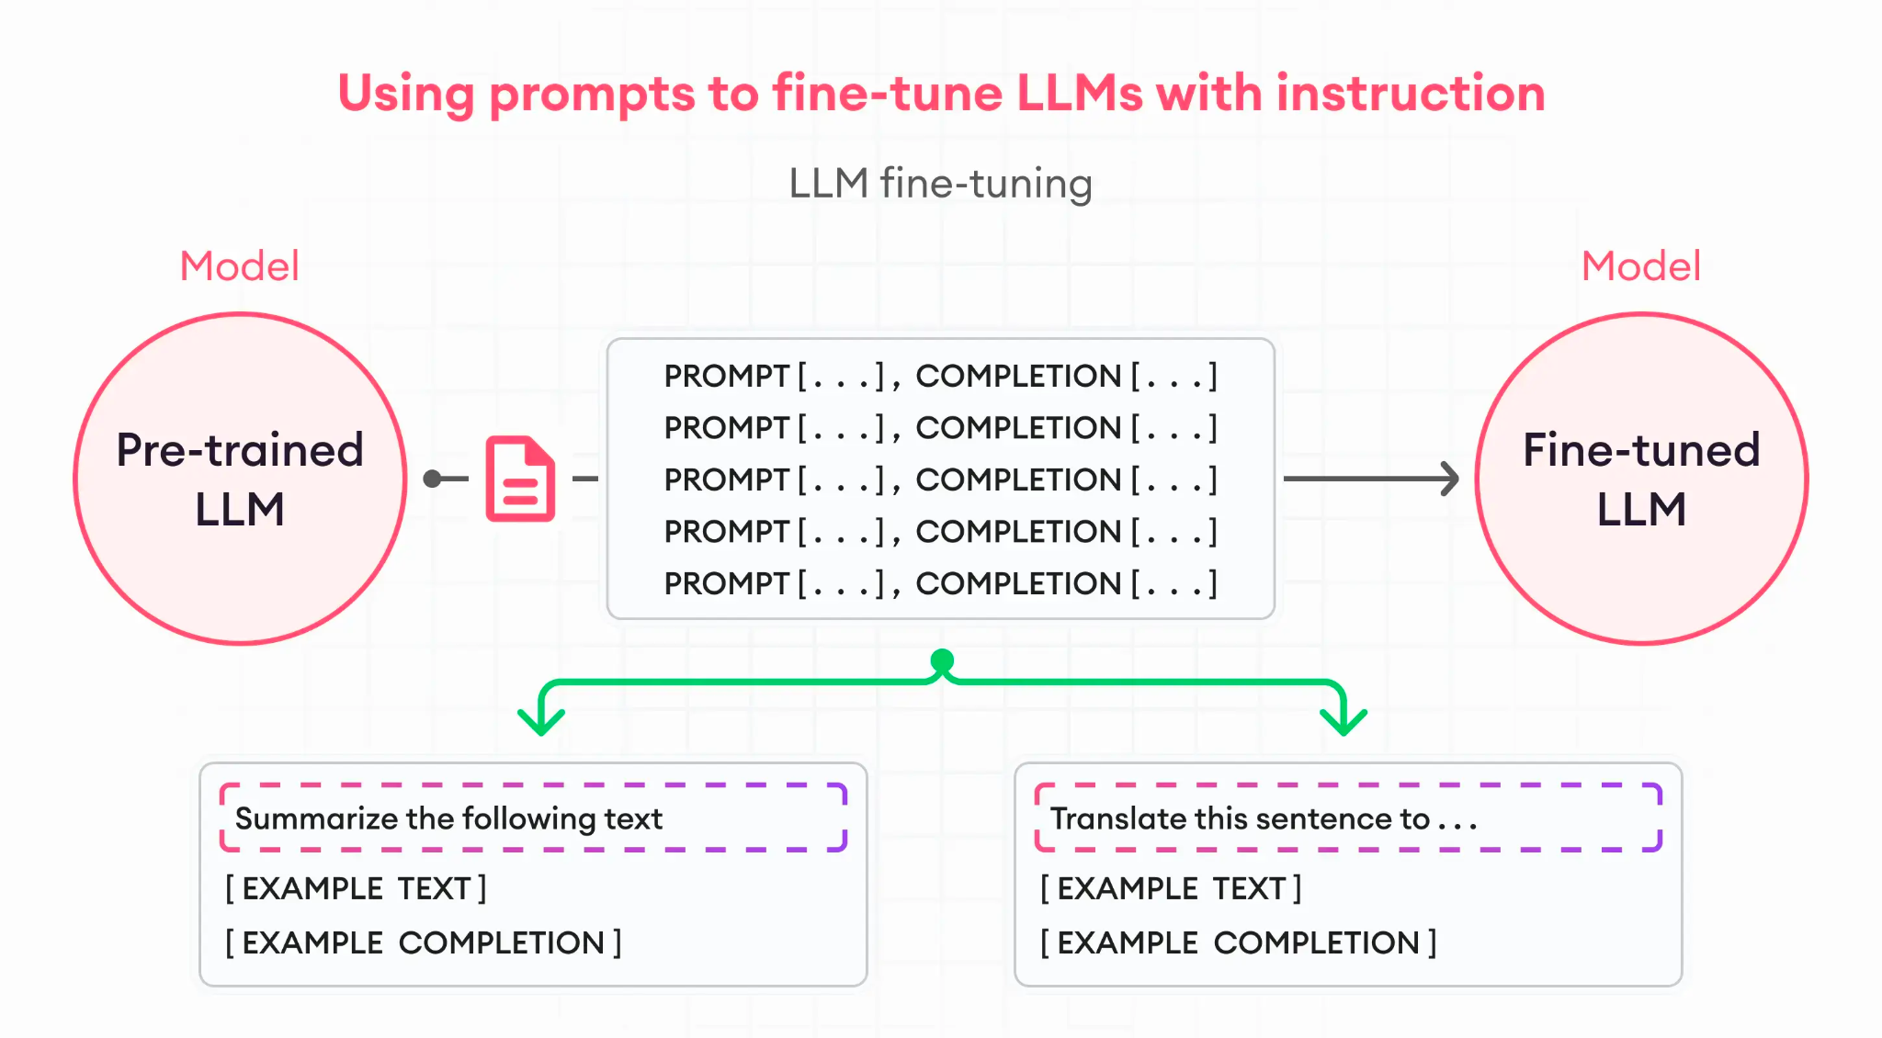
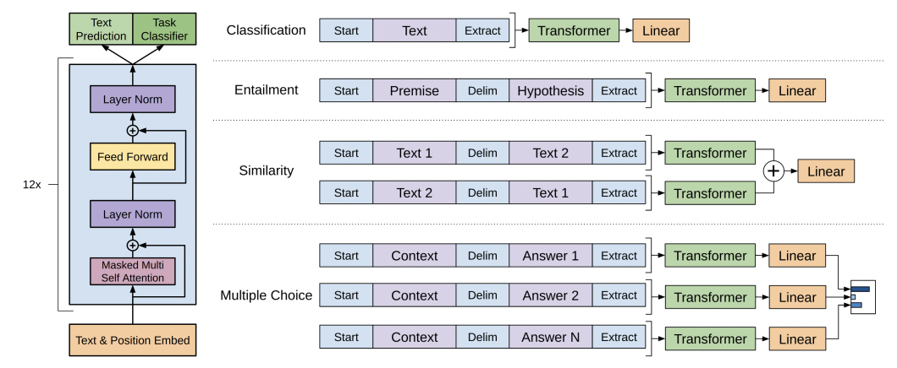
Related Work
AI VIETNAM
Seminar
Supervised Finetuning
Train base models on specific, specialized tasks
Finetuning in GPT paper
Instruction Finetuning

Slide 15
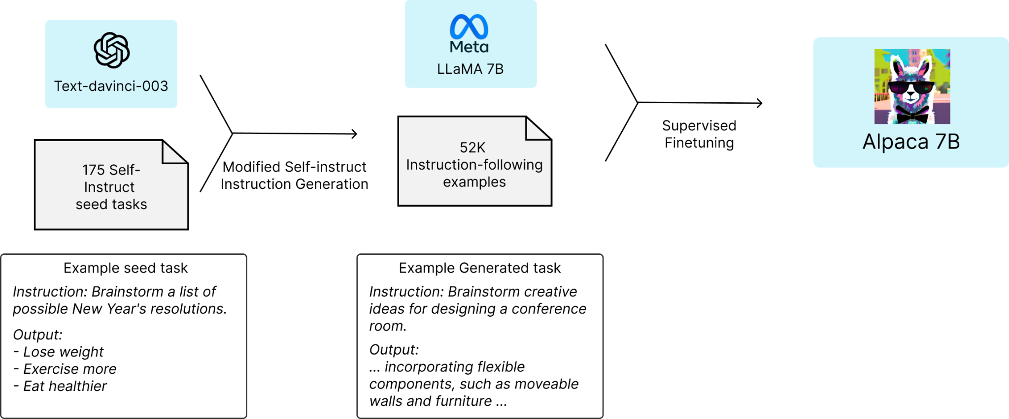
Related Work
AI VIETNAM
Seminar
Supervised Finetuning
Synthetic Data: Generate instruction and answer from ChatGPT.
Stanford Alpaca

Slide 16
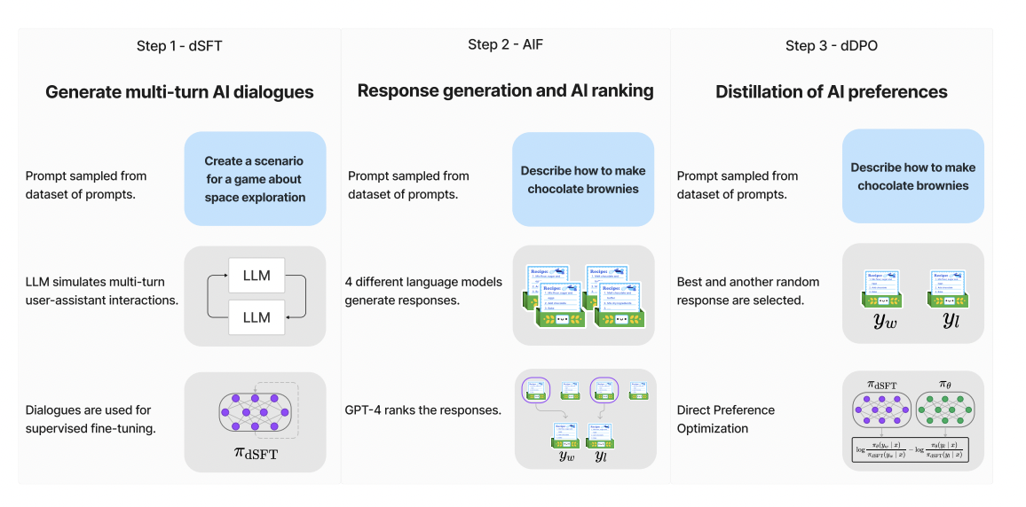
Related Work
AI VIETNAM
Seminar
Supervised Finetuning
Synthetic Data: Generate instruction and answer from ChatGPT.
Optimize answer quality with RLHF (InstructGPT); Alternative: PPO/DPO.
ZEPHYR: DIRECT DISTILLATION OF LM ALIGNMENT

Slide 17
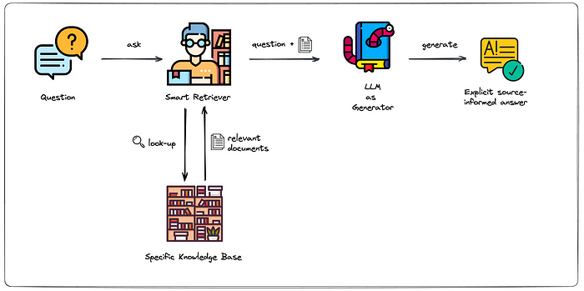
Related Work
AI VIETNAM
Seminar
Retrieval Augmented Generation
LLMs are powerful, but:
They are static
They lack of domain specific knowledge
They functions as “black box”
They are insufficient and costly produce
We can utilize the “few shot learning” by give LLMs the context

Slide 18
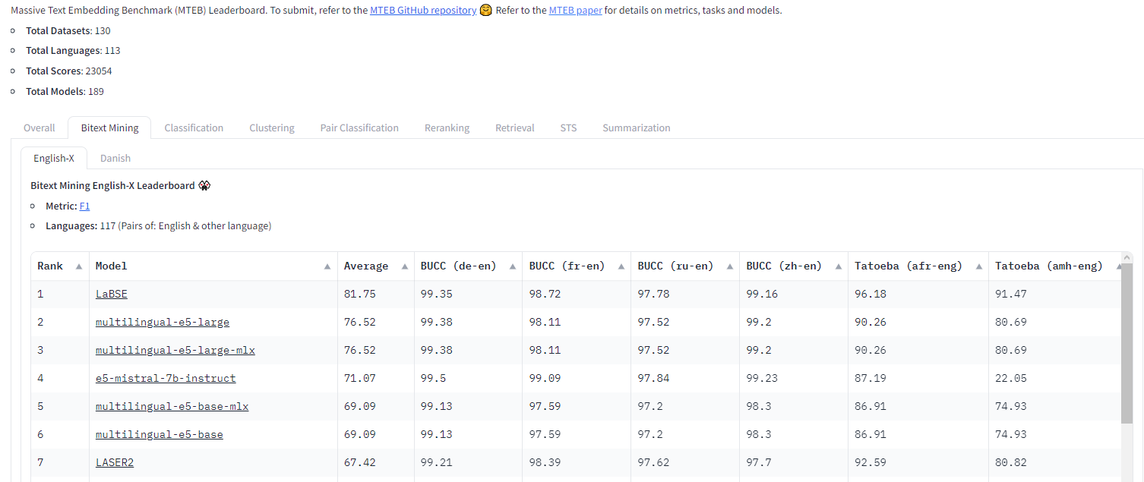
Related Work
AI VIETNAM
Seminar
Context embedding
Some popular model for using as embedding are e5-base-v2, e5-larg-v2, gte-base, gte-large
MTEB Leaderboard

Slide 19
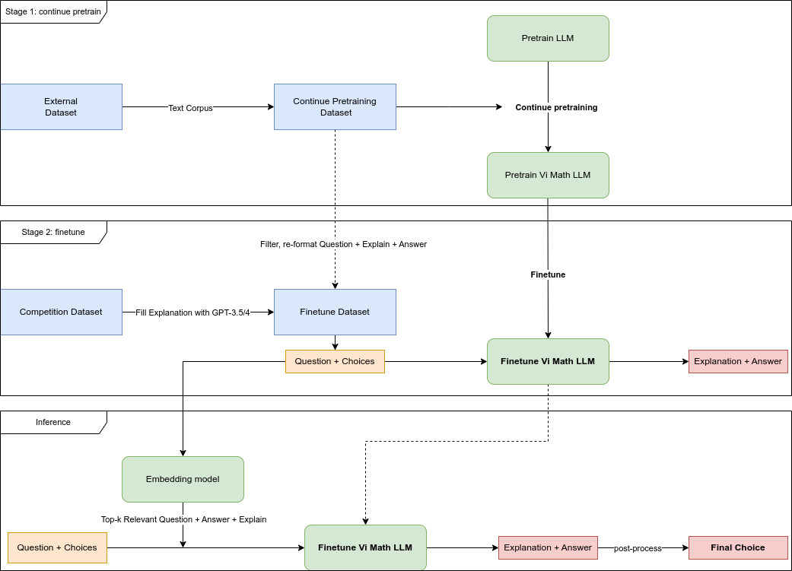
Proposed Method
AI VIETNAM
Seminar
Proposed Method

Slide 20
Proposed Method
AI VIETNAM
Seminar
Data preparation
Clean competition training dataset:
Filling missing Explanation field with GPT-4.
Clean / Filter error examples.
External dataset: Corpus text crawled from online teaching websites for elementary school students and the benchmark dataset is translated into Vietnamese to take advantage of the above two stages.
Not using leakage: Not using hand labeling public test and training the model

Slide 21
Proposed Method
AI VIETNAM
Seminar
Data preparation - Continue Pretraining dataset
Dataset Name | Filename | Size
Vietnamese Translated Grade School Math Dataset | vi_train_raw.json, vi_test_raw.json | 8792
Vietnamese Elementary Math Knowledge and Workbook - Text | grade_{1,5}.json | 10246
Vietjack Text | vietjack_pretrain.json | 13615
Total |  | 32653

Slide 22
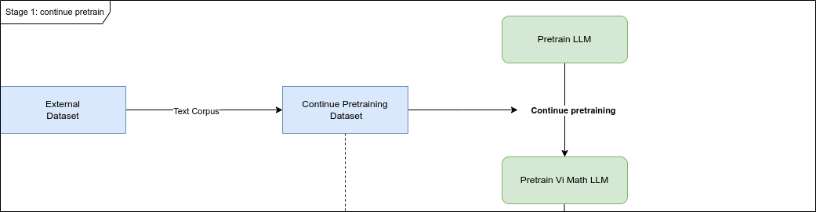
Proposed Method
AI VIETNAM
Seminar
Continue Pretraining
Reason for this step:
For model learning and tokenizer extends the vocabulary.
Make the LLMs finetuning step convergen more faster.
By experiments: This steps could boost the model performance around 2,3% comparing with bare base model

Slide 23
Proposed Method
AI VIETNAM
Seminar
Finetuning Dataset
Dataset Name | Filename | Size
Qualified Dataset from Competition | convert_qualified_data.json | 1196
Collected Dataset | convert_qualified_data.json | 140
Vietnamese Elementary Math Knowledge and Workbook | grade_{3,5}_mcq.json | 5206
Vietnamese Elementary Math Knowledge and Workbook | vietjack_finetune.json | 2115
Total |  | 8657

Slide 24
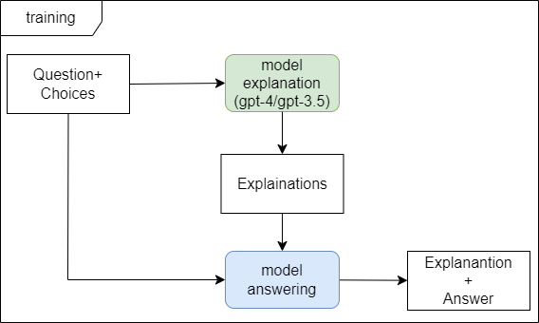
Proposed Method
AI VIETNAM
Seminar
Supervised Finetuning
In this step:
We trained model using both explanation and answer.
Experiments:
Changing pretrained model from stage 1.
Changing rank in LoRA.
Learning rate.
Earlystopping.
Improve dataset quality. (most impact)

Slide 25
Experiments
AI VIETNAM
Seminar
Continue pretraining
Base model | Train loss | Eval loss | Eval Accuracy | Eval Perplexity
Llama-2 7B | 0.5671561380291116 | 0.6204795241355896 | 0.831146229075127 | 1.8598196564670118
Mistral-7b-v0.1 | 0.5717931843230705 | 0.605161726474762 | 0.8357321441998862 | 1.8315483947998228
zephyr-7b-beta | 0.5778149476435406 | 0.6088958978652954 | 0.8344175985305018 | 1.838400495913874
Qwen-7B | 0.9038185586734694 | 0.9308816194534302 | 0.7710786622703721 | 2.5367446354805163
BloomZ-7b1 | 1.2220947331637801 | 1.241927146911621 | 0.7222003923855691 | 3.4622793605962974

Slide 26
Experiments
AI VIETNAM
Seminar
Supervised Fintuning
Base model | Finetuning | Train loss | Eval loss | Public test accuracy
hllj/mistral-vi-math | BaoLocTown/sft-mistral-7b-vi-math-v1-clean-valid | 0.2929 | 0.4370269775 | 0.5238
hllj/Zephyr-beta-7B-Vi-Math | BaoLocTown/sft-zephyr-beta-7b-vi-math-v1-clean-valid | 0.2968 | 0.4378368258 | 0.6878
hllj/Llama2-7B-Vi-Math | BaoLocTown/sft-llama2-7b-vi-math-v1-clean-valid | 0.3555 | 0.4689075351 | 0.4126

Slide 27
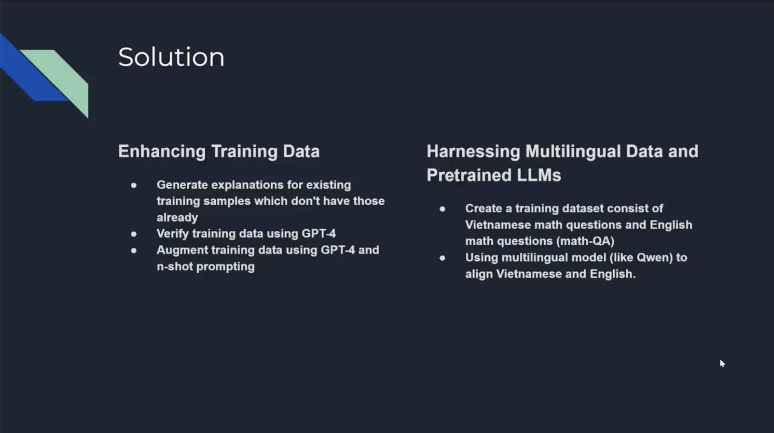
Top solutions
AI VIETNAM
Seminar
Top solutions

Slide 28
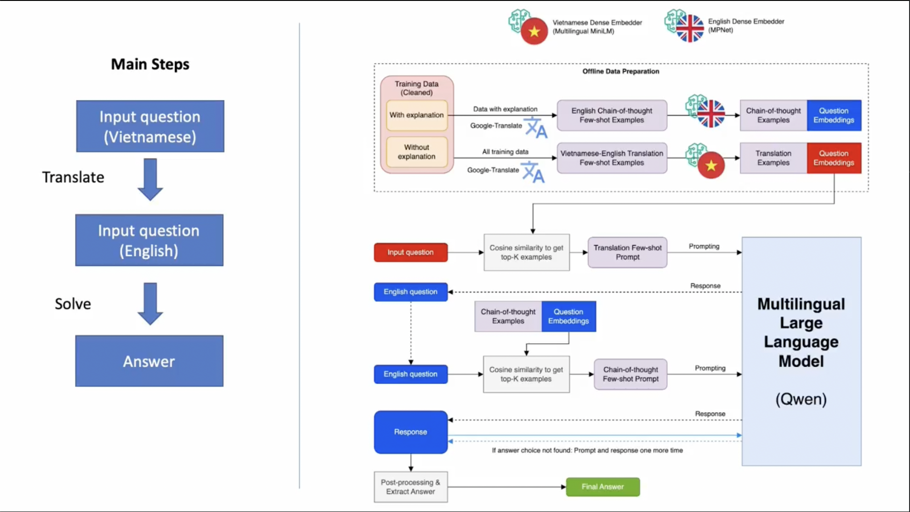
Top solutions
AI VIETNAM
Seminar
Top solutions

Slide 29
Conclusion
AI VIETNAM
Seminar
Key notes
Methods to enhance reasoning ability of LLM
The importance of data quality and base models.
Synthetic data from LLM.
Enrich knowledge context, few-shot with Retrieval-Augmented Generation.
Further Research, experiments:
Different base models: Vistral-7B-Chat
Using more data for embeddings. (promising)
Using PPO (Proximal Policy Optimization) and DPO (Direct Preference Optimization)

